Slide 1


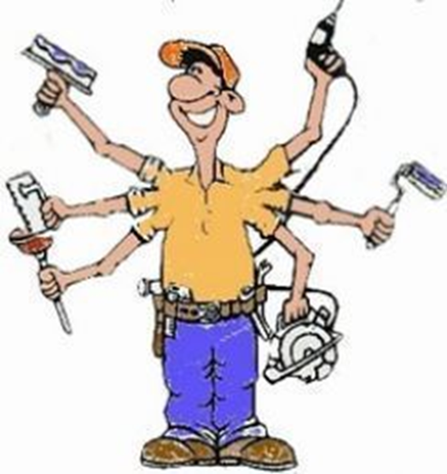
Kwa Thema Skills School
(School Of Specialization)
Maintenance Year 1
Learner's Guide

Slide 2
Maintenance Year 1
Learning Content
1. Woodwork 6. Plumbing
1. Safety Rules. 1. Safety Rules.
2. Basic Tools. 2. Basic Tools.
2. Building and Plastering 7. Painting
1. Safety Rules. 1. Safety Rules.
2. Basic Tools. 2. Basic Tools.
3. Metalwork 8. Waterproofing
1. Safety Rules. 1. Safety Rules.
2. Basic Tools. 2. Basic Tools.
4. Electricity 9. Glazing
1. Safety Rules. 1. Safety Rules.
2. Basic Tools. 2. Basic Tools.
5. Mechanical 10. Flooring
1. Safety Rules. 1. Safety Rules.
2. Basic Tools. 2. Basic Tools.

Slide 3
Overview of Maintenance
- Maintenance management is vital in ensuring the long term success of your maintenance program by monitoring quality assurance, maintaining operational efficiency and keeping assets in optimum running order.
- Properly maintained assets and resources keep your production stable and greatly minimize the chances for unplanned downtime.
At the end of the term learners should be able to know:
1. Woodwork basic safety rules and tools.
2. Building and Plastering basic safety rules and tools.
3. Metalwork basic safety rules and tools.
4. Electricity basic safety rules and tools.
5. Motor Mechanics basic safety rules and tools.
6. Plumbing basic safety rules and tools..
7. Painting basic safety rules and tools.
8. Waterproofing basic safety rules and tools.
9. Glazing basic safety rules and tools.
10. Flooring basic safety rules and tools.

